Slide 1
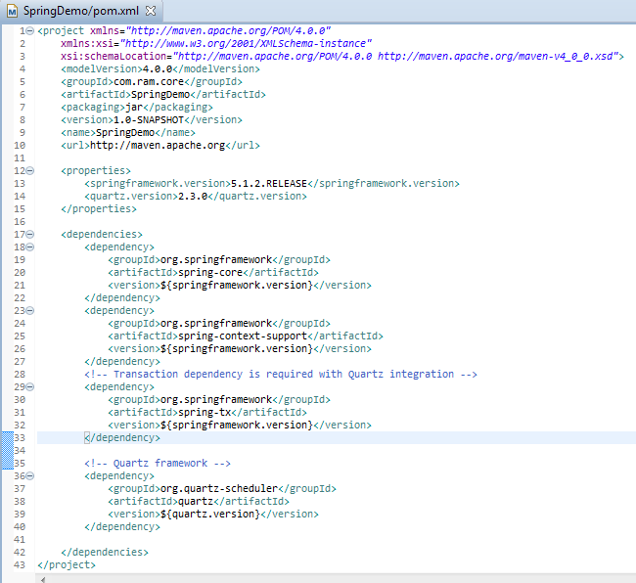
Spring 5 + Quartz Scheduler Integration Example[Using MethodInvokingJobDetailFactoryBean]

Slide 2
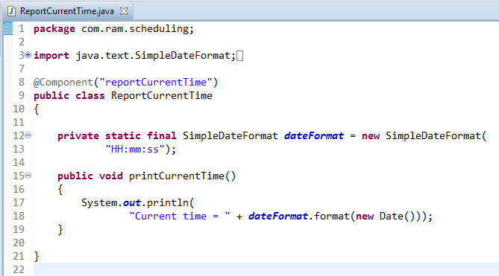
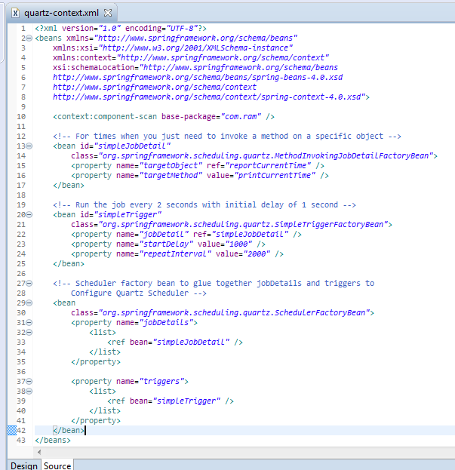
Spring 5 + Quartz Scheduler Integration Example[Using MethodInvokingJobDetailFactoryBean]
invoke a method on a specific bean
SchedulerFactoryBean glues together jobDetails and triggers to Configure Quartz Scheduler

Slide 3
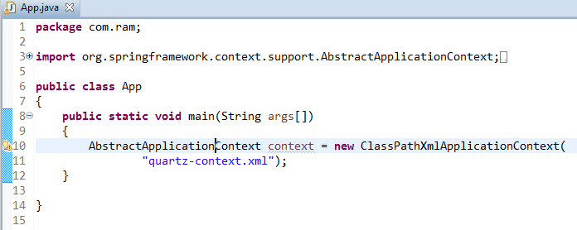
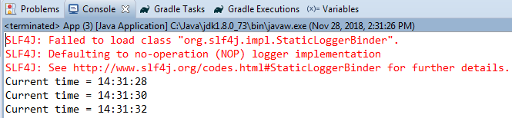
Spring 5 + Quartz Scheduler Integration Example[Using MethodInvokingJobDetailFactoryBean]

